Slide 1
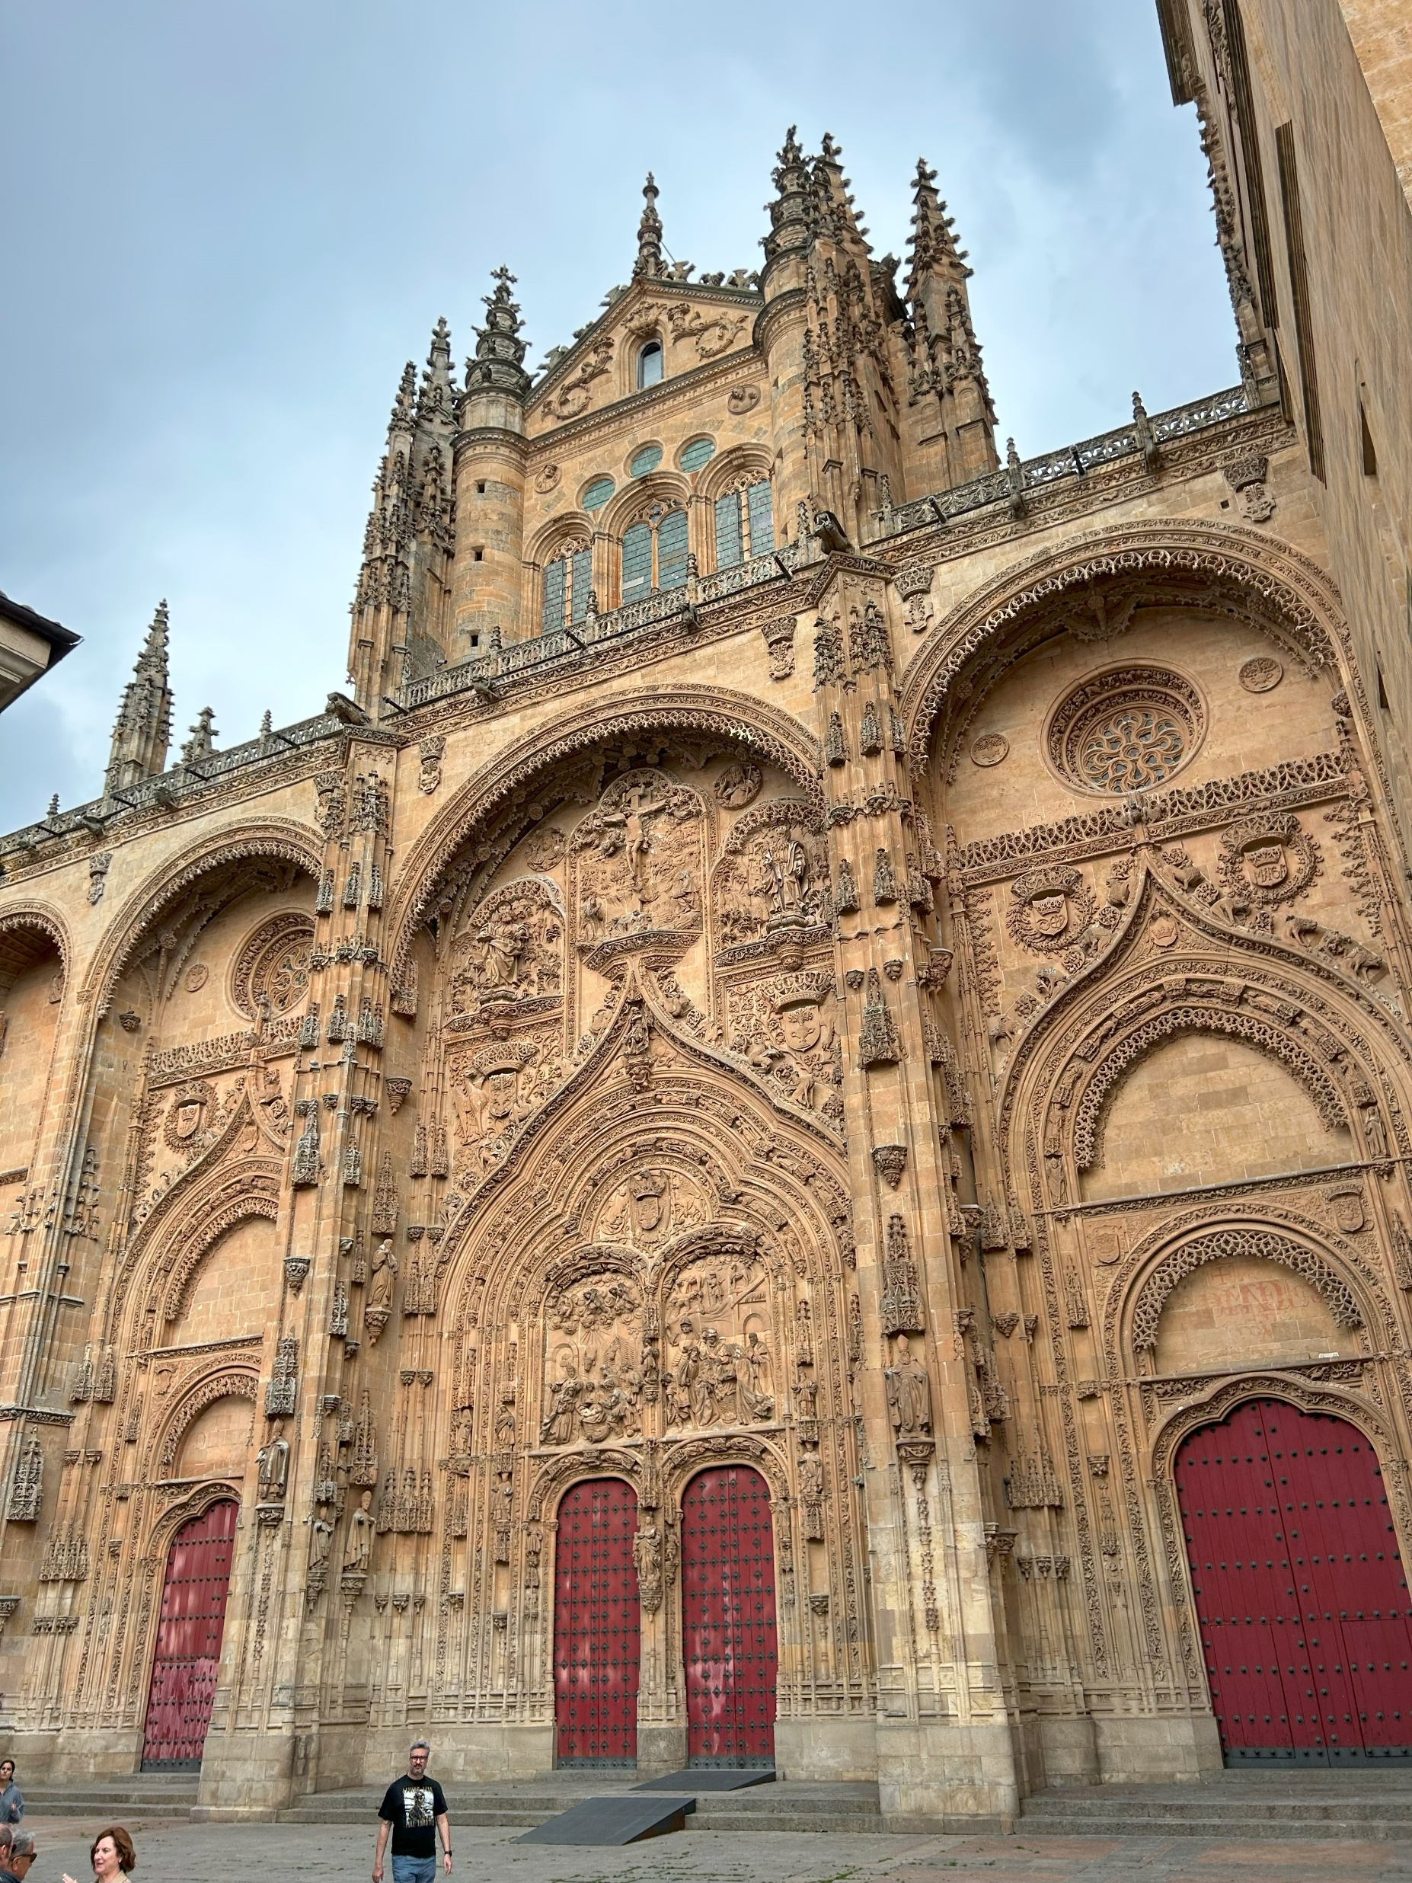
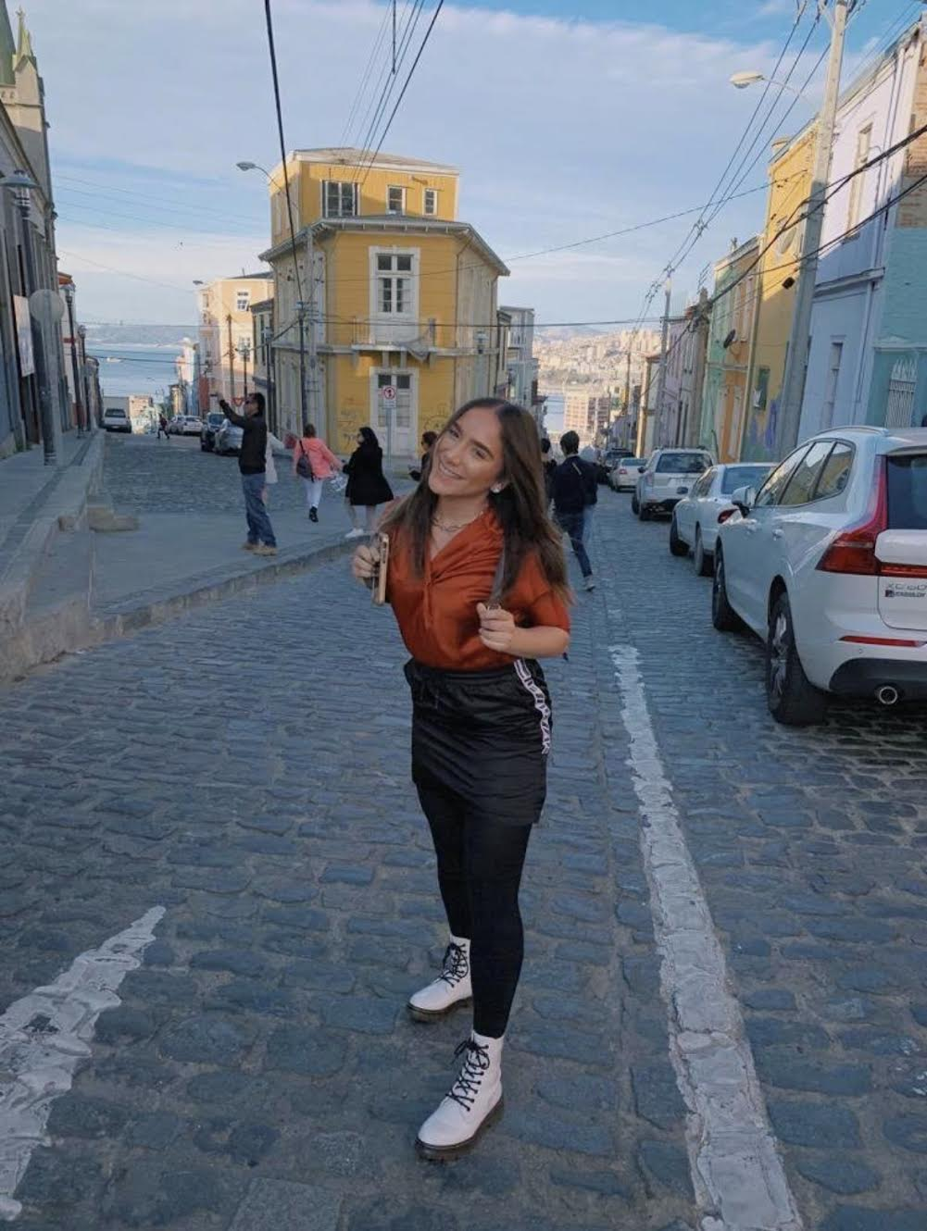
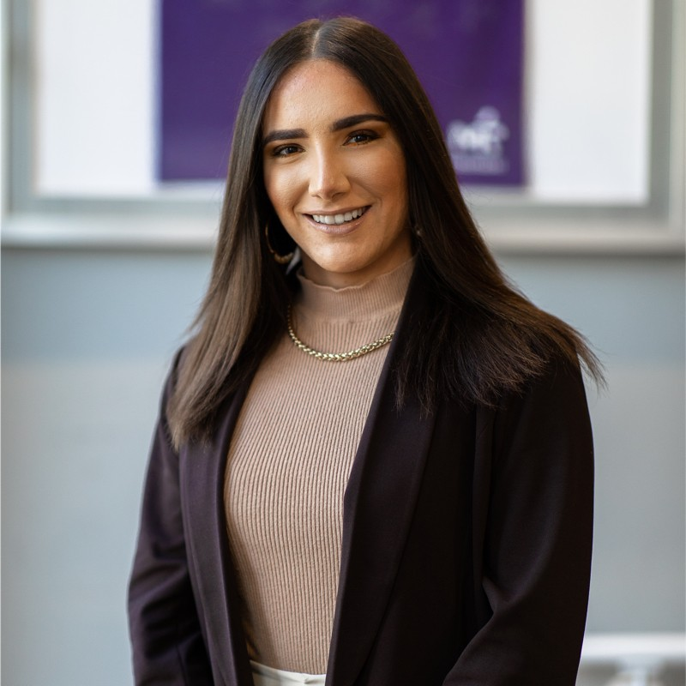
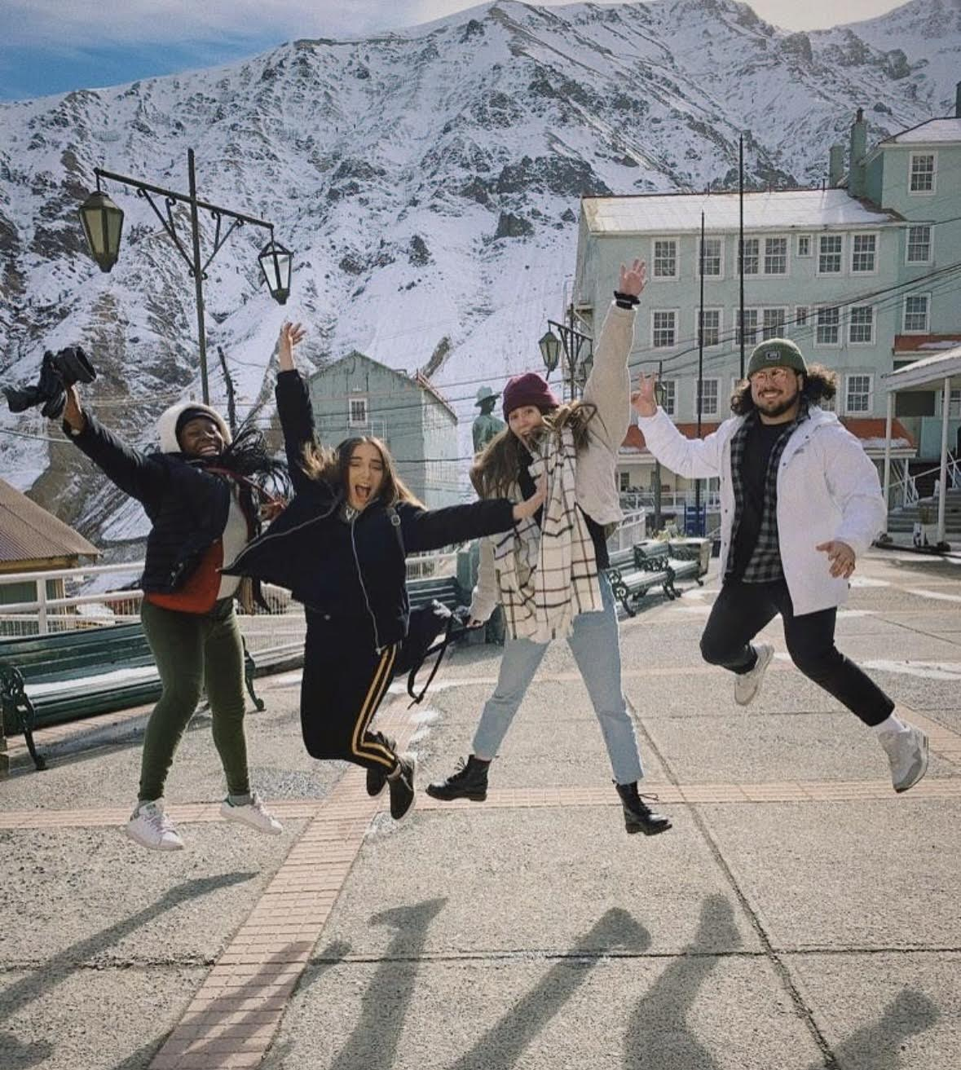
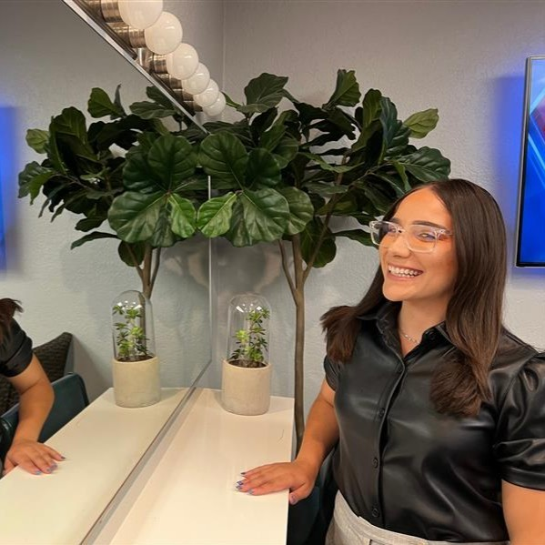
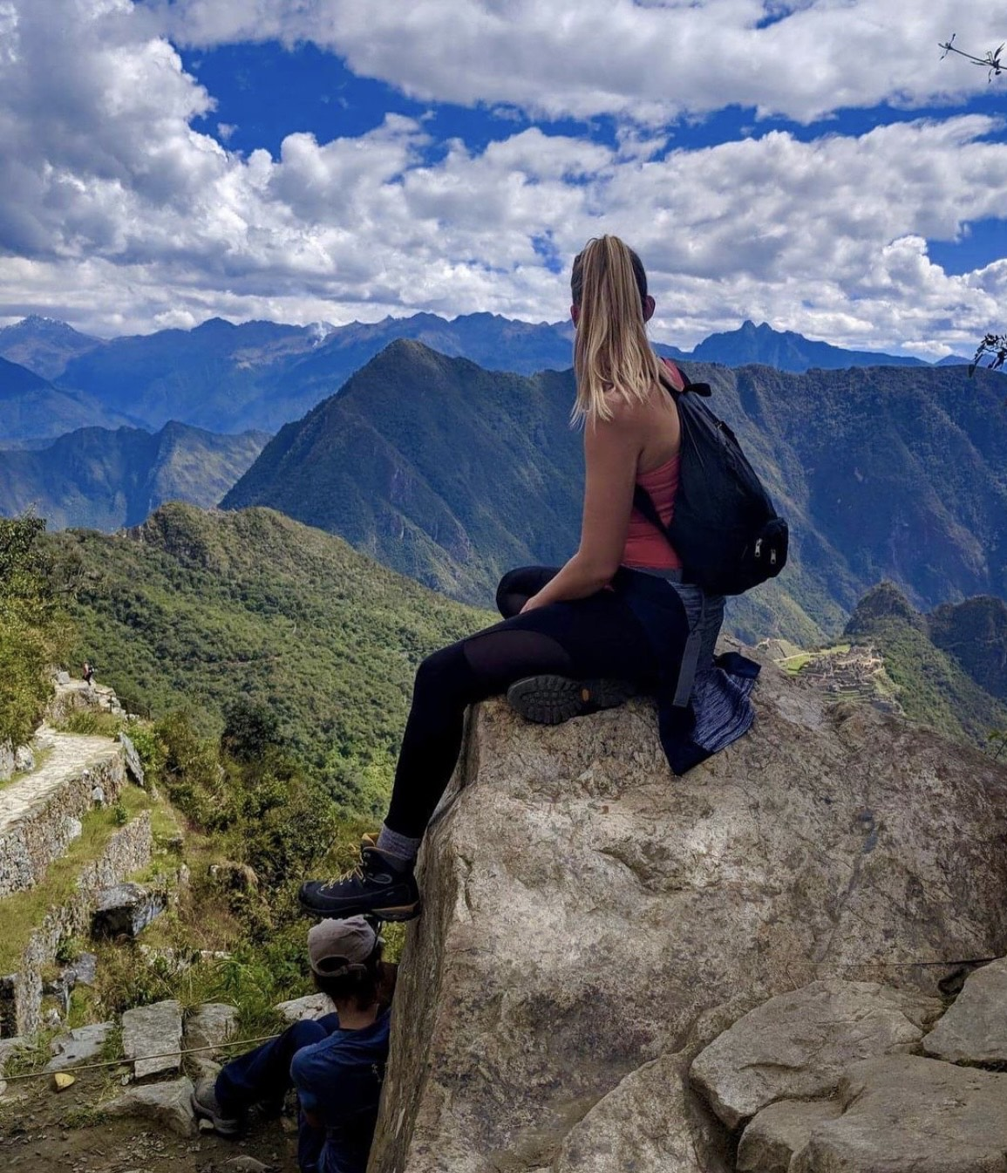
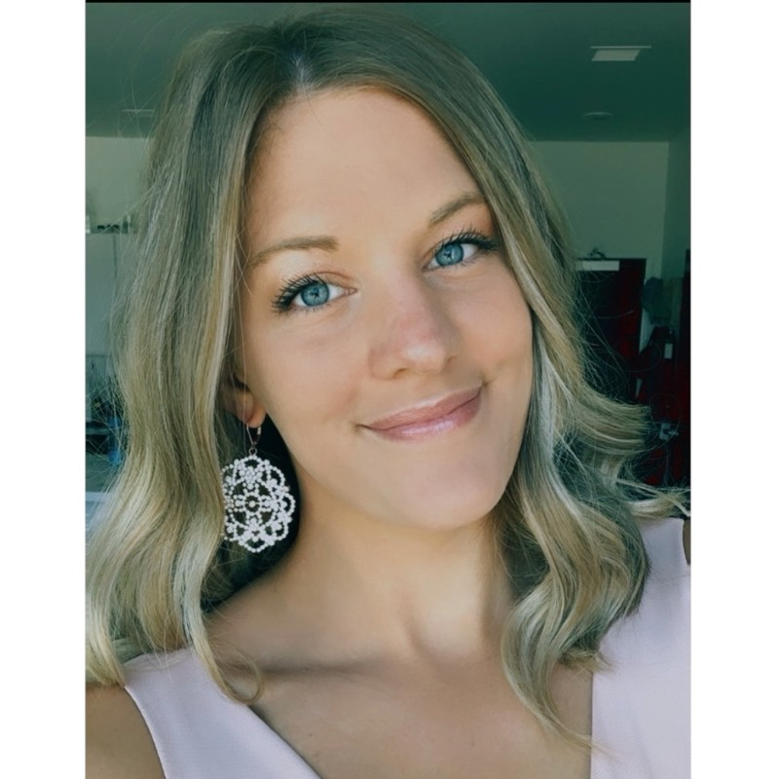
Copywriting for the Adrian College Spanish Major
Public Relations Capstone Project
Dylan Butler
Goals
\
Goal One: Improve Copy on the Spanish Overview & Faculty Pages
Overview Page Proposed Content:
Include important information about the value of an education in the Humanities, such as Spanish
Explain the advantage of understanding Spanish-speaking cultures
Emphasize the value of speaking a second language in the workforce
Highlight opportunities to travel abroad
Add statistics. Here are a few statistics that will be included:
Spanish is the second most widely spoken language in the world
475 million native speakers
Faculty Page Proposed Content:
Professors' bio lines will include their work and publications
Add a favorite quote from a Latin American or Spanish-speaking author to each bio (idea from Hillsdale pages)
Our professors have extensive backgrounds in Spanish-speaking culture with tons of work either on literature or informative online content on Spanish grammar. These things should be featured in their bios on the department’s page.
The Adrian College Spanish faculty are passionate educators and by adding a favorite quote the faculty page will better highlight the personality of each faculty member.
Goal Two: Add Content to the Spanish Alumni Page
Alumni Page Proposed Content:
Highlight the study abroad opportunities alumni have participated in
Include info on careers to showcase the diversity in Spanish alumni
Include alumni who double majored to show additional opportunities at Adrian
With pictures, we can convince people to join in on a semester abroad and
enjoy a priceless experience. I reached out to various alumni through LinkedIn and sent Google forms outs to collect information.
Alumni Profiles
Salamanca, Spain 2023
Nicole Buddie | 2020 Graduate
Major(s): Communication & Spanish
Current Job:​ Assignment Editor, Fox 5 San Diego
Studied Abroad: Santiago, Chile
Project Overview
My capstone project for my Bachelor of Science in Public Relations was updating the Adrian College Spanish Major's web pages. I had previously helped the Adrian College Geology and Physics programs update their web pages in fall 2023 and as a double major in Spanish and Public Relations, I wanted to use my copywriting skills to help Spanish with updates.
This redesign included an updated copy for the major’s overview, faculty, career options, alumni, and curriculum pages. These changes will help the department showcase the benefits of a Spanish major and the opportunities it offers to students.
Before beginning edits, I completed an audit of similar programs at comparable colleges. Among the websites I reviewed, I found the design of Hillsdale College's Spanish major to offer several good ideas. Similar to Adrian, it is a Michigan private, liberal arts college with a Spanish Major program.
I drew inspiration from other Adrian College department pages that have been updated such as the Music Department and Physics page. Adrian’s website has seen a renovation recently and the Spanish major still needs to update its pages.
Jordan Pizzo in Lima, Peru
Current Job: Lead Client Facing Recruiter Manpower Group
Studied Abroad: Studied abroad in Lima, Peru -
Victoria Buddie | 2020 Graduate
Major(s): Communication & Spanish
Current Job:​ Morning News Writer, Fox 5 San Diego
Studied Abroad: Santiago, Chile
Target Publics
Undergraduate Students at Adrian College
High School Students
Prospective Transfer Students
Jordan Pizzo | 2019 Graduate
Major(s): Communication & Spanish
Current Job: Lead Client Facing Recruiter Manpower Group
Studied Abroad: Peru

